Slide 1
Opiate Analgesics
Susan Stickevers, MD
Residency Program Director, SUNY Stony Brook Dept of PM&R

Slide 2
Opioid Misuse/ Abuse is a Major Public Health Problem
Improper use of opiates can result in serious adverse events including overdose and death
The risk of death is increased in patients on extended release formulations
In 2010, over 425,000 emergency room visits involved non medical uses of opioids
Methadone is involved in 30% of prescription opiate deaths

Slide 3
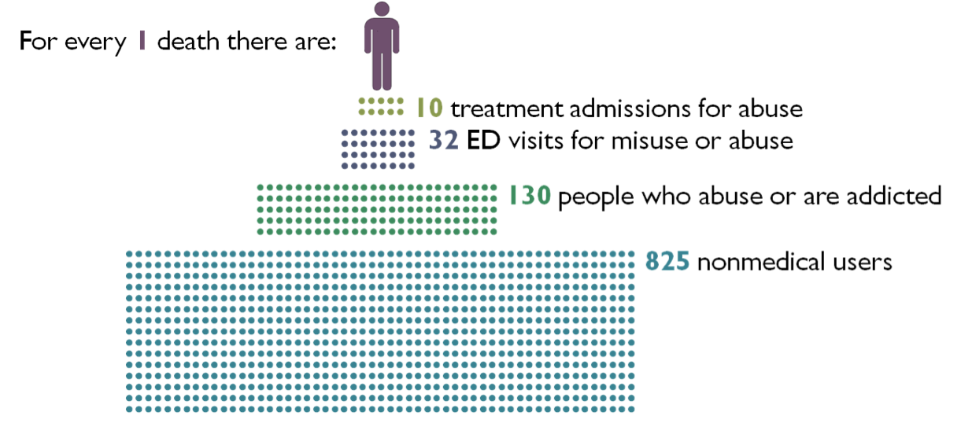
In 2009, 14,800 People Died in the US from a Prescription Drug Overdose

Slide 4
When Prescribing Opiates for Pain, Always Consider Risk Vs. Benefit Ratio
Potential Benefits
  Pain Control
  Improved Function
Potential Risks
  Overdose
  Abuse
  Misuse
  Addiction
  Physical Dependence
  Tolerance
  Interactions with other drugs & substances
  Inadvertent exposure to household contacts, including children

Slide 5
Clinical Considerations when History Taking Before Prescribing Opiates
Pulmonary Disease
Renal Disease
Hepatic Disease
Constipation
Cognitive Impairment
Nausea
Illnesses Possibly Linked to Substance Abuse :
  Hepatitis
  HIV
  TB
  Cellulitis
  STIs
  Trauma, Burns

Slide 6
Clinical Interview
What causes or increases the pain ? (pain generator)
What relieves the pain?
Effect of pain on physical, emotional, and psychosocial function
Patient’s pain & functional goals

Slide 7
Physical Examination of the Pain Patient
Conduct a physical examination and document vital signs, appearance, posture, gait and pain behaviors
Conduct a neurological examination
Conduct a thorough musculoskeletal examination, including inspection, palpation, and provocative testing

Slide 8
Assessment of the Pain Patient
Seek objective confirmatory data – including xrays, MRI, CT, or EMG as indicated
Order appropriate tests, including urine toxicology and ethyl glucuronide levels
Query the state Prescription Drug Monitoring Program (PDMP)
Contact past providers and obtain old medical records
Document non pharmacological strategies which have been or can be employed to relieve the patient’s pain and document the effectiveness of these interventions (epidurals, acupuncture, spinal manipulation)
For those patients already on opioids, document the opiate used, the dose, regimen and duration to determine if the patient is opiate tolerant

Slide 9
Assessment Risk of Abuse, Including Substance Abuse & Psychiatric History
Obtain a history of current & past substance abuse :
  Prescription Drugs
  Illicit substances
  Alcohol Use
  Tobacco Use
Social History is also relevant :
  Employment
  Cultural Background
  Social Network
  Marital History
  Legal History
  Behavioral Problems

Slide 10
Always Perform a Risk Assessment for Abuse & Diversion
Patients who are more likely to abuse opiates are :
  Younger
  Have a personal history of substance abuse
  Have a family history of substance abuse
  Have a psychiatric diagnosis of depression

Slide 11
Always Perform A Risk Assessment – For Risk of Respiratory Arrest
Many deaths of patients receiving opiates are due to concomitant ingestion of opiates with alcohol or benzodiazepines.
Use only minimal doses of opiates in patients already on benzodiazepines
Use minimal doses of opiates in patients with a history of sleep apnea
Never start a patient who is using alcohol on opiates – order urine ethyl glucuronide levels prior to starting opiates, inquire about alcohol use when taking the history
Respiratory arrest is more likely to occur in patients who are elderly, cachexic, or debilitated
  Altered opiate pharmacokinetics are seen in patients with poor fat stores, muscle wasting, or altered clearance

Slide 12
Opiate Induced Respiratory Arrest
Patients are at increased risk of a respiratory arrest within the first 24-72 hours of initiating opiate therapy or within 24-72 hrs. of a dose increase
Respiratory arrest is more common in patients who chew, crush, or dissolve extended release medications rather than swallowing the tablets whole
Do not overestimate dosing when switching (rotating) one opiate to another as this can result in fatal overdose with the first dose
Extended release opiates are intended for opiate tolerant patients only

Slide 13
Opiate Tolerance
Extended release opiates are only for opiate tolerant patients
Opiate tolerant patients are those who have been on any of the following agents for one week or longer :
  60 mg oral IR Morphine Sulfate
  25 mcg transdermal fentanyl
  30 mg oral oxycodone / day
  8 mg hydromorphone / day
  25 mg oral oxymorphone / day
  Or an equianalgesic dose of any other opioid
These patients still require close attention when rotating from one long acting opioid to another opioid

Slide 14
Opioid Rotation
Definition : Change from an existing opiate regimen to another opioid with the goal of improving therapeutic outcomes or avoid adverse events / side effects of attributed to the drug the patient is currently using
Rationale: Differences in pharmacologic or other effects make it likely that a switch (rotation) will improve outcomes
Effectiveness and side effects of different mu opioids vary among patients
Patients show incomplete cross tolerance to new opiates
Patients tolerant to the first opioid can have improved analgesia from second opioid at a dose lower than calculated from an equianalgesic dosing table.

Slide 15
Equianalgesic Dosing
Opioid rotation entails the calculation of an approximate equianalgesic dose
It is a construct derived from relative opioid potency estimates
There are many different versions of equianalgesic dosing tables (EDTs):
  Published
  Online interactive
  Online
  Smart phone apps

Slide 16
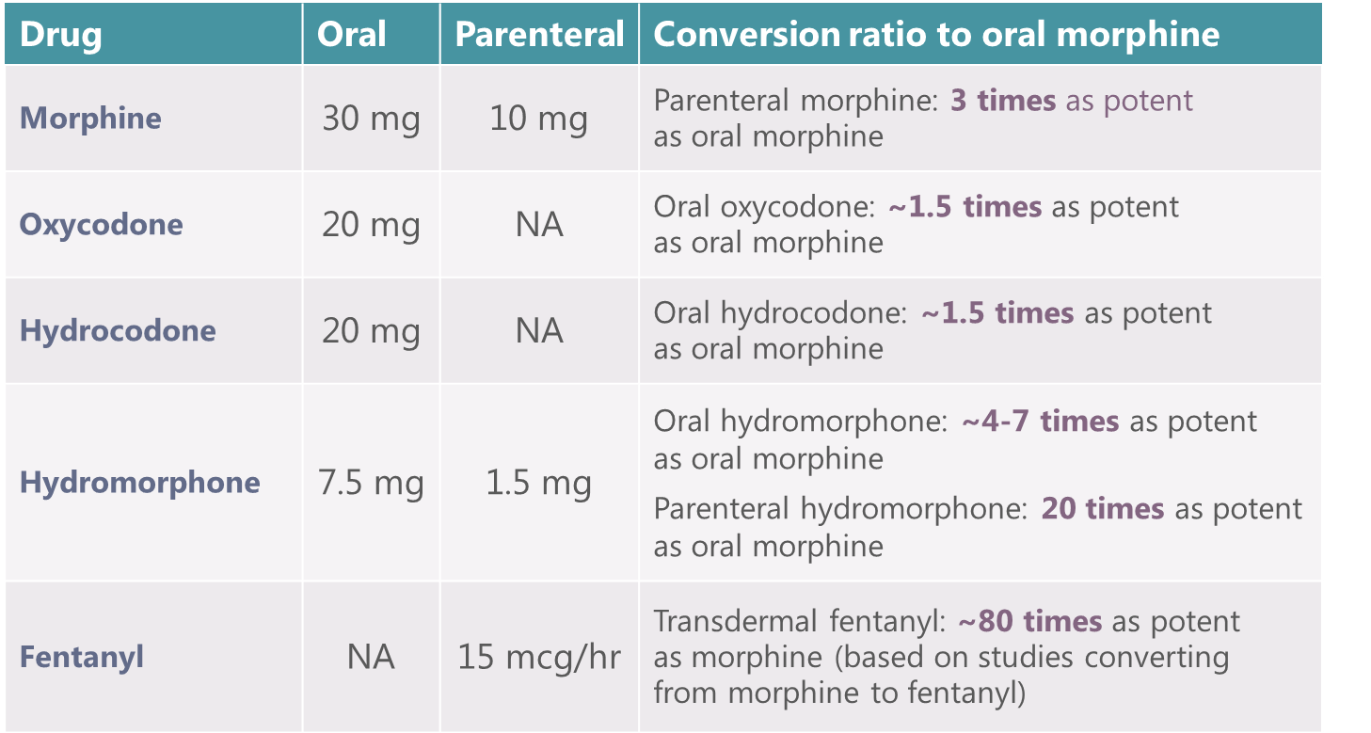
Examples of an EDT

Slide 17
Calculating the Equianalgesic Dose
Incomplete cross tolerance and inter – patient variability require use of conservative dosing when converting from one opiate to another
Equianalgesic dose is the starting point for calculation of dose for an opiate rotation
The calculated dose of the new drug based on EDT must be reduced, then titrate the new opioid as needed.
Closely follow patients during periods of dose adjustment

Slide 18
Guidelines for Opiate Rotation
Calculate the equianalgesic dose of the new opioid from the EDT
Reduce the calculated equianalgesic dose by 25-50%
  Choose 50% dose reduction if patient is receiving a relatively high dose of the current opioid regimen or if the patient is elderly or medically frail
  Choose 25% dose reduction if you are only switching to an alternate route of administration of the same drug, or if patient is on a low dose of opiates, or if the patient is young and otherwise healthy

Slide 19
Guidelines for Opiate Rotation to Methadone
If switching to methadone, reduce the calculated equianalgesic dose by 75% - 90%
For patients on a very high opiate dose >1000 mg morphine, be cautious when converting to methadone > 100 mg / day
Consider serial EKG monitoring in this situation

Slide 20
Breakthrough Pain
Immediate release drug is administered at 5-15% of the total daily opiate dose
If dose required to reduce breakthrough pain is greater than 15%, the dose of the extended release medication must be increased
Do not use extended release medication for breakthrough pain
Consider adding non opioid pharmacological agents to reduce pain, called adjuvant analgesics
Adjuvant analgesics : anti spasticity agents, anticonvulsants, NSAIDs
Non pharmacological treatments can be ordered to reduce breakthru pain, including exercise, interventional procedures, acupuncture , spinal manipulation.

Slide 21
Monitoring Programs are Based Upon Risk Assessment
High risk patients must be placed on intensive monitoring programs if opiates are used
Low risk patients receive standard monitoring programs
We monitor for aberrant drug behaviors

Slide 22
Aberrant Drug Behaviors
Examples of Aberrant Behaviors Include :
  Unsanctioned dose escalations
  Non compliance with therapy
  Unapproved use of the drug to treat symptoms than pain i.e.. anxiety, depression, sleep disorder
  Acquiring opioids from other clinicians
  Prescription forgery
  Obtaining prescription drugs from non medical sources
  Urine toxicology study contains drugs not prescribed
  Urine toxicology positive for illicit substances
  Urine toxicology negative for the prescribed drug
  Loss or “theft” of prescribed medications
  Medication reconciliation (pill count) reveals missing tablets suggesting abuse or possible diversion

Slide 23
Always Have a PPA
PPA= a patient – prescriber agreement
Should be signed by both the patient and the provider
Clarifies the treatment plan & goals of treatment
Informs patients of the risks & benefits of treatment
Document patient and provider rights & responsibilities

Slide 24
Always Counsel Patients To :
Refrain from sharing, selling, or trading opiates with someone else
Store the opiates in locked cabinet or safe in your home taking only one day supply on your person
Keep opiates away from children and pets
Dispose of opiates when they are no longer needed – you may flush extra pills and dispose of medication vials in the trash after identifiers have been scratched off the vial- there are also prescription drug disposal centers and drop boxes
Transdermal medications should be removed and adhesive surfaces folded against each other and flushed down the toilet – a patch that has been used for 3 days still has enough medication in it to kill a child
Do not abruptly stop opiate use as this can trigger withdrawal

Slide 25

Prescription Drug Monitoring Programs (PDMP)
49 states & 1 territory have legislation authorizing a PDMP
43 states have an operational PDMP
Individual State Laws Determine :
  Who has access to PDMP information
  Which drug schedules are monitored
  Which agency administers the PDMP
  Whether prescribers are required to register w/ the PDMP
  Whether prescribers are required to access PDMP information in certain circumstances
  Whether unsolicited PDMP reports are sent to prescribers

Slide 26
Always Be Sure to Check the PDMP Website Prior to Prescribing Opiates !
Checking the NYS PDMP is required :
  Within 24 hours of admission if ordering narcotics
  Prior to writing a prescription for opiates at time of discharge
  Prior to writing a prescription for an outpatient
  Not required to check for a hospice patient
  ER may give up to a 5 day supply of opiates without checking the PDMP in NY State

Slide 27
When to Consider a Trial of an Opioid
When pain is moderate – severe
Failure of the patient to respond to non opiate, non drug interventions, i.e. epidurals, exercise, PT, acupuncture, spinal manipulation
Potential benefits outweigh risks – consider referral to an interventional pain specialist or addiction medicine specialist when risks outweigh benefits
When continuous around the clock analgesics are needed around the clock for an extended period of time
No alternative therapy is likely to provide as favorable a balance of benefits to harms

Slide 28


Opium Poppies – Source of The Naturally Occurring Opiates, Morphine & Codeine

Slide 29
Opiates- Receptors, Classes & Selection of Opiates

Slide 30
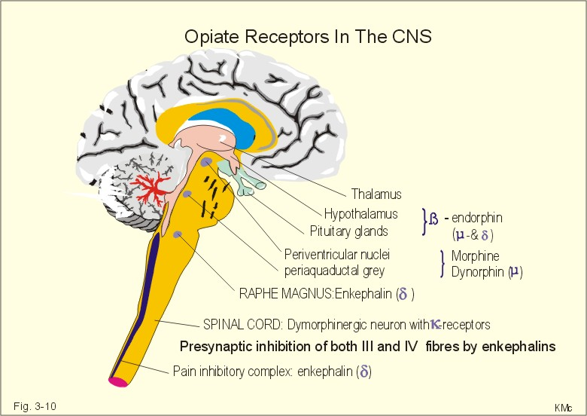
Locations of Opiate Receptors
Found at both pre and post synaptic sites in the ascending pain transmission system in the dorsal horn of the spinal cord, the brain stem, thalamus, and cortex
Opioid receptors are also found in the descending inhibitory modulating pathways of the midbrain periaqueductal gray matter, nucleus raphe magnus, the rostral ventral medulla – these modulate spinal pain transmission.

Slide 31
Opiate Receptors
Receptor Type | Endogenous Opiate Agonist | Exogenous Agonists | Exogenous Antagonist
Mu | *Beta Endorphin* | Morphine | Naloxone
Delta | *Enkephalin* | TAN - 67 | Naltrindole
Kappa | *Dynorphin* | TRK – 820, opiate agonists – antagonists act at this receptor, including butorphanol & pentazocine | Norbinaltorphimine

Slide 32
3 Kinds of Opiate Receptors
Mu receptors influence responses to mechanical, chemical and thermal nociception at a supraspinal level
  Mu receptors also mediate the undesirable side effects of opiate analgesics, including respiratory depression, constipation, and physical dependence
Kappa opiate receptors modulate spinally mediated thermal nociception and chemical visceral pain
Delta receptors may modulate mechanical nociception & inflammatory pain

Slide 33
How Opiate Receptors Work
Endogenous or exogenous opioid peptides bind to opioid receptors to modulate mechanical nociception and control pain sensitivity
Opioid receptors have extracellular transmembrane regions that provide receptor specificity and intracellular regions that link to G proteins
Activation of the opiate receptor sends a signal via potassium ion channels and protein kinase C enzyme systems located in the cytosol and cell membrane resulting in both reduction of the action potential duration and neurotransmitter release

Slide 34
Mu Opioid Agonists
Phenanthrenes
Morphine
Hydrocodone
Hydromorphone
Oxycodone
Oxymorphone
Codeine
Diphenylheptanes
Methadone
Propoxyphene*
Phenylpiperidines
Meperidine
Fentanyl
Sufentanyl
Alfentanyl
Remifentanyl

Slide 35
Opiate Agonist – Antagonists
Includes butorphanol, nalbuphine, pentazocine
They act as agonists at the kappa receptor, and antagonists at the mu receptor

Slide 36
Opiate Partial Agonist Analgesics – Buprenorphine
Opioid partial agonist analgesics bind to an opiate receptor producing a fraction of the full opiate response
Buprenorphine is an example of a partial agonist at the mu receptor
Used to help patients overcome opiate addiction
In order to use Suboxone in the state of NY, you must take a special course
Subutex, the buprenorphine-only formulation, is available as 2 mg and 8 mg sublingual tablets
Suboxone, the buprenorphine and naloxone combination product, is available as sublingual tablets in doses of 2 mg buprenorphine/0.5 mg naloxone, and 8 mg buprenorphine/2 mg naloxone.
Naloxone is added to buprenorphine to decrease the potential for abuse by the parenteral route.
The use of a partial agonist can offer some analgesia with a ceiling effect
Later administration of full agonists can result in partial antagonist effects

Slide 37
Buprenorphine Transdermal System (BuTrans)
Transdermal system changed every 7 days
Initial dose in opioid tolerant patients on < 30 mg morphine equivalents & in mild – moderate hepatic impairment is 5 mcg/hour
When switching from an oral agent, first taper 30-80 morphine equivalents down to 30 mg morphine equivalent, then initiate BuTrans at 10 mcg/hr.
May titrate dose up after patient has been on BuTrans for a minimum of 72 hrs.
Maximum dose is 20 mcg./hr due to risk of QTc prolongation

Slide 38
BuTrans
Apply topically to non irritated, intact skin
Prep site by clipping hair, wash site with water only, then dry
Rotate application sites – wait a minimum of three weeks prior to re-using an application site
Do not cut or damage the system
Avoid exposure to heat
Disposal : fold adhesive sides together and flush down the toilet or use disposal kit included with the drug

Slide 39
BuTrans
CYP3A4 inhibitors may increase buprenorphine levels
CYP3A4 inducers may decrease buprenorphine levels
Concomitant use of benzodiazepines increases the risk of respiratory depression
10 mcg and 20 mcg patches are only for opiate tolerant patients

Slide 40
BuTrans
Use of this drug along with Class 1 A and III anti-arrhythmics increases the risk of prolonged QTc intervals prolongation & torsade de pointes
It is hepatotoxic so you must check LFTs and hepatitis serologies before prescribing this drug
Equipotency to morphine has not been determined.

Slide 41
Opioid Antagonists
Bind to opiate receptors producing no or low antagonist activity that may reverse or inhibit effects of opioid agonists by preventing receptor access
Naloxone, naltrexone, nalfmefene are useful for reversing opiate induced sedation and respiratory depression
Naltrexone is used in the treatment of both opiate and alcohol addiction

Slide 42
Federal Controlled Substances Schedules
 | Description of Criteria | Examples
Schedule 1 C - I | High Potential for Abuse Lack of Accepted Safety Data No accepted medical use | Heroin, LSD, mescaline, methaqualone
Schedule 2 C – II | High Potential for Abuse Severe psychological & physical dependence liability accepted medical use | Morphine, hydromorphone, oxycodone, cocaine, amphetamine, methadone, methylphenidate
Schedule 3 C-III | Less abuse potential than 1 or 2 Moderate or low physical dependence or high psychological dependence Accepted medical use | Opioids combined with non narcotic drugs : percocet, dronabinol, anabolic steroids, benzphetamine, proposed move of hydrocodone containing combination drugs to Schedule 2
Schedule 4 C-IV | Less potential for abuse than C I- CIII Limited physical / psychological dependence Accepted medical use | Benzodiazepines, chloral hydrate, dextropropxyphene, phenobarbital, fenfluramine, tramadol
Schedule 5 C – V | Low Abuse Potential Limited physical / psychological dependence Accepted medical use | Dephenoxylate / Atropine antidiarrheal meds, Anti- Tussives with small amnt. codeine

Slide 43


Slide 44
Morphine
The prototypical mu opiate receptor agonist against which all other opiates are compared for equianalgesic potency
Can be administered by IV, epidural, intrathecal, rectal and oral routes

Slide 45
Morphine : Equivalence Between IV/IM Vs. Oral Dosing
**Remember : 10 mg IV or IM Morphine Sulfate is equivalent to 30 mg po**

Slide 46
Oral Morphine
Available as sustained release and immediate release preparations
May be used in sustained release form for chronic pain, and in immediate release form for post op pain & breakthru pain
Sustained release formulations : MS Contin, Kadian, Avinza, Embeda

Slide 47
Morphine : Pharmacology
Morphine has an oral bioavailability of 35 – 75%
Due to its relative hydrophilicity, it is a less than ideal analgesic
Its transport across the blood brain barrier is frequently delayed, and therefore it has a slower onset of action compared to the other opioids
Morphine has a relatively longer duration of analgesic effect of 4 – 5 hours relative to its plasma half life ( 2 - 3.5 hrs) thereby minimizing its accumulation & contributing to its safety
The disproportionate duration of analgesia vs. plasma half life is due to its low solubility & slower elimination from the brain relative to the plasma concentration
IR form is administered 10 – 30 mg po q 4 hours

Slide 48
Morphine Metabolites
Morphine’s effect as an analgesic is primarily due to the parent compound, however its efficacious & toxic effects are also seen as a result of 2 of its major metabolites, morphine 3 glucuronide (M3G)& morphine 6 glucuronide (M6G)

Slide 49
M3G
Lacks any mu or delta opiate receptor activity – its mechanism of action is unknown
Accounts for 50% of morphine’s metabolites
Demonstrated to cause hyperalgesia, CNS irritability, seizures, myoclonus, and opiate tolerance in animals
Believed to cause neuroexcitatory side effects in humans as well

Slide 50
M6G
A mu and delta receptor agonist
Accounts for 5 – 15 % of morphine metabolites
It has intrinsic opioid agonist effects and it sustains analgesia

Slide 51
Metabolites & Modes of Morphine Administration
IV & rectal administration of morphine avoids hepatic metabolism and glucuronide concentrations are less than with oral administration

Slide 52
Glucuronides
Chronic administration of morphine sulfate orally results in higher concentrations of glucuronides than the concentration of the parent compound
Mean rations of M3G : M6G are approximately 5:1
Patients experiencing side effects from the metabolites are candidates for rotation to an alternative opiate

Slide 53
Precautions For Morphine Usage
MSO4 elimination is dependent on hepatic metabolism
Use it with caution in cirrhotic patients
Morphine metabolites are also renally excreted, thus the dose should be reduced in renal failure
Patients with renal failure develop encephalopathy and myoclonus due to the accumulation of morphine metabolites, in particular, M3G

Slide 54
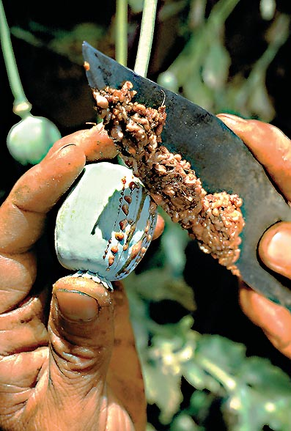

Slide 55
MS Contin
Dosed every 8-12 hours
Titrate dose up at a minimum of 2 day intervals between dose increases
Swallow tablets whole, do not crush or chew
PGP inhibitors (ie quinidine) may increase absorption of morphine by a factor of 2

Slide 56
PGP Inhibitors
Reserpine
Ritonavir
Tariquidar
Verapamil
Quercetin
Quinidine
Amiodarone
Azithromycin
Captopril
Clarithromycin
Cyclosporine
Piperine

Slide 57
Morphine Sulfate ER Capsules (Kadian)
Dosed once a day or Q12 hours
Package insert recommends against using this as first opioid
Titrate dose up at a minimum of Q2 day intervals
Swallow capsule, whole, but you may open the capsule and sprinkle the pellets on applesauce for patients who cannot reliably swallow without chewing
Do not use with alcohol as this can result in rapid release and absorption of the drug
PGP inhibitors like quinidine may increase absorption of the drug 2 fold

Slide 58
Morphine Sulfate ER Capsules (Avinza)
Once daily dosing only
Titrate up at 3 day intervals
Initial dose in opiate tolerant patients is 30 mg / day
Maximum daily dose is 1600 mg due to renal toxicity of excipient fumaric acid
Swallow capsule whole, may open capsule and sprinkle pellets on applesauce for patients who cannot swallow
Concomitant use of alcohol may result in rapid release and absorption of drug resulting in potentially fatal overdose
PGP inhibitors like quinidine may increase drug absorption by a factor of 2

Slide 59
Morphine Sulfate ER - Naltrexone Tablets (Embeda)
Dosed once per day or Q 12 hours
Initial dose as a first opioid : 20 mg MSO4/0.8 mg naltrexone
Titrate up at 3 day or more intervals
Do not chew, crush, or dissolve
Crushing or chewing will release morphine rapidly, possibly resulting in an overdose, naltrexone will also be released possibly resulting in a withdrawal syndrome
Do not use with alcohol due to concerns about rapid release and potentially fatal overdose
Don’t use with PGP inhibitors
100 mg / 4 mg capsule is for use in opiate tolerant patients only

Slide 60
Codeine (Methylmorphine)
One of the two naturally occurring opiates (morphine & codeine)
Is a derivative of opium, just as morphine is
Short acting
Available PO / IV / IM
Frequently administered with APAP, as Tylenol #2, Tylenol #3, Tylenol #4
Commonly used as an anti – tussive
Administered every 4 – 6 hrs.
Metabolized in the body to codeine, (70%) norcodeine, (10%),morphine (10%), normorphine, (4%) and hydrocodone (1%)
Essentially it is a pro – drug. Conversion in the body to its metabolite, morphine, is responsible for its analgesic properties

Slide 61
Codeine
Codeine has a poor affinity for opioid receptors in the brain.
As a pain medication, its effect occurs because of partial (approximately 10%) metabolism to morphine in the liver.
The active enzyme in the liver responsible for conversion to morphine is the P450 2D6 enzyme.
The 2D6 enzyme is also active in the metabolism of many medications, including paroxetine, sertraline, and others.
Approximately 10% of the Caucasian population lacks 2D6 enzyme metabolic activity.
It would be expected that those with limited 2D6 activity would get little or no analgesic effect from codeine
Of interest, codeine is effective on the cough reflex regardless of the conversion to morphine

Slide 62


Slide 63
Oxycodone
Is the semi – synthetic cogener of morphine which has been used as an analgesic for over 80 yrs.
Available as a short acting or long acting opiate
It is available as a short acting opiate in immediate release preparations as oxycodone IR or roxicodone
The short acting preparation is also compounded with aspirin (called endodan or percodan) or acetaminophen (called percocet, endocet, or roxicet)
Short acting compound comes as 5 and 10 mg tablets every 4 – 6 hrs

Slide 64
Long Acting Oxycodone
Is available as the drug oxycontin in the US
Q12 hr dosing schedule
More potent than morphine
Shorter onset of analgesia than morphine
Less variation in plasma levels than morphine
Associated with fewer side effects than morphine (less confusion, sedation, hallucinations, dizziness, and pruritis)
Oxycodone itself has some intrinsic opiate agonist activity thru activation of kappa receptors, but it basically is a pro – drug

Slide 65
Oxycodone ER (Oxycontin)
Dosed every 12 hours
Opioid naïve patients : Starting dose is 10 mg po Q12 hours
Titrate at a minimum of 1-2 day intervals
Hepatic impairment: start with ⅓-½ usual dosage
Renal impairment (creatinine clearance <60 mL/min): start with ½ usual dosage
CYP3A4 inhibitors may increase oxycodone levels
CYP3A4 inducers may decrease oxycodone levels
Approximately 2:1 oral morphine to oxycodone oral dose ratio
Dosing greater than 40 mg for patients who are opioid tolerant only
Cannot be used in patients who have swallowing dysfunction

Slide 66
Metabolism of Oxycodone
Oxycodone is a pro-drug
It undergoes hepatic metabolism via the cytochrome P4502D6 where it is converted to the mu opiate agonist, oxymorphone & the inactive noroxycodone
  Oxymorphone is an active metabolite with mu opioid agonist which is 14X more potent than the parent compound
  Noroxycodone is an inactive metabolite

Slide 67
Oxycodone & Cytochrome P450 2D6
About 10% of the population has genetically low levels of cytochrome P450 2D6 enzyme
These individuals may need higher doses of oxycodone to achieve analgesia than the average individual
Analgesic efficacy may also be decreased in those patients who are concurrently taking medications which competitively inhibit the P450 enzyme
Careful dose titration must be made in those who concurrently take SSRIs, TCAs, or neuroleptics
The kidneys excrete oxycodone, therefore, the dose should be adjusted in renal dysfunction

Slide 68


Slide 69
Hydrocodone
semi-synthetic opioid derived from two of the naturally occurring opiates, codeine and thebaine
Most frequently prescribed opiate in the US, and one of the most frequently abused drugs
Known in the US as Vicodin, Lorcet, Lortab, Norco.
Most popular formulation : as a tablet in combination with APAP, called Vicodin
Also is available in a combination tablet with ibuprofen, called Vicoprofen
Standard Vicodin Tab : 5.0 mg with APAP
Vicodin ES : 7.5 mg with APAP
Reaches peak effect in 0.5 – 1 hr.
Duration of analgesia is 3 – 4 hrs
Typically dosed every 4 – 6 hrs.
No significant interaction with adjuvant analgesics

Slide 70
Hydromorphone
Marked in the US as Dilaudid
Hydrogenated ketone analog of morphine that can be formed by n-demethylation of hydrocodone
Can be administered via IV, IM, SQ, epidural, intrathecal, rectal, or PO routes of administration

Slide 71
Hydromorphone Immediate Release (Dilaudid)
Oral short acting drug marketed in the US as 4 and 8 mg tablets, and 3 mg rectal suppositories
A hydrophilic compound which has strong mu opiate receptor agonist activity
5 – 7 x more potent than morphine
Time to Onset of Analgesia : 30 minutes if administered orally, 5 minutes to onset if administered parenterally
Duration of analgesic effect : 3 - 4 hours
Side effects of nausea, pruritis, sedation, and vomiting occur less frequently with Dilaudid
Typically dosed every 4 – 6 hrs.

Slide 72
Hydromorphone Extended Release Tablets (Exalgo)
Dosed once per day
Titrate up at 3-4 day intervals
Swallow tabs whole, do not crush or chew
Start the patient with moderate hepatic impairment on 25% of the recommended dose
Start the patient with moderate renal failure on 50% of the recommended dose, patients with severe renal failure on 25% of the recommended dose
Do not use in patients with sulfite allergy as it contains sodium metabisulfite
~ 5 : 1 oral morphine to hydromorphone dose ratio

Slide 73


Slide 74
Tapentadol ER (Nucynta)
An opiate agonist
Dosed Q 12 hours
50 mg po Q12 hours is the initial dose in non opioid tolerant patients
Swallow tablets whole one at a time with water – do not chew or crush
Do not take this medication with alcohol
Titrate up by 50 mg increments at a minimum of three day intervals between dose increases
Maximum daily recommended dose is 500 mg / day
Maximum dose is 100 mg /day in moderate hepatic impairment
Avoid use in severe hepatic and renal impairment
Cannot use with MAO inhibitors
Risk of serotonin syndrome when used with SSRI and SNRI
Risk of angioedema
Equipotency with morphine has not been established

Slide 75
Methadone
Originally called Adolfine, after Adolf Hitler
Then name was changed to Dolofine
Now called methadone which is an acronym for : 6 dimethylamino 4,4 diphenyl 3 heptanone
Highly lipophilic & basic (pka = 9.2)
Totally synthetic
Administered by oral, rectal or parenteral administration
Delayed clearance from the body and long half life permit this drug to be given once daily for opiate maintenance programs for prevention of withdrawal symptoms for up to 24 hrs.
Dispensed as 5, 10, 20 mg tablets
Initial dose for non opiate tolerant patients : 2.5 – 5 mg
Dosed every 8-12 hours

Slide 76
Methadone for Analgesia
Not administered once daily for analgesia unlike methadone maintenance for drug addiction
Duration of analgesia following each dose : 6 – 8 hrs.
Onset of analgesia : 2 hrs post administration
Has no known metabolites
Undergoes hepatic metabolism by cytochrome P450 system, specifically CYP3A4
Peak absorption is dependent upon gastric pH, patients who are willing to take omeprazole will absorb more methadone
CYP 450 inducers may decrease methadone levels
CYP 450 inhibitors may increase methadone levels
Antiretroviral drugs have mixed effects on methadone levels and it is advised not to use methadone in HIV patients on these drugs
Coadministration with benzodiazepines is not recommended due to risk of respiratory depression
Coadministration with other agents which prolong the QT interval is contraindicated

Slide 77
Methadone
Usually exists in a racemic mixture of two isomers, d methadone and l methadone, both of which have separate modes of action
The d isomer antagonizes the NMDA receptor & inhibits 5 hydroxytryptamine & norepinephrine reuptake
The l isomer possesses opioid receptor agonist properties

Slide 78
Methadone
Methadone has a lower affinity than morphine for the mu opioid receptor
This explains why methadone has fewer mu opioid related side effects
Methadone has a higher affinity for the delta opiate receptor than morphine
Its action at the delta receptor prevents opiate induced tolerance and dependence
Its action at the NMDA receptor also prevents the development of tolerance

Slide 79
Methadone
Advantages :
  Low Cost
  Long acting
  High Bioavailability
  Multiple receptor affinities
  No known metabolites with neurotoxicity
  Does not accumulate in renal failure patients
  Not significantly removed by dialysis
  The tablets may be broken in half and chewed
  Available as an elixir for use in gastrostomy tubes
Disadvantages :
  Unpredictable bioavailability
  High inter-individual variability in steady state serum levels with half lives varying from 75 -175 hrs. / half life
  Auto – induces activity of the cytochrome P450 subtype CYP3A4 which is responsible for its metabolism, so methadone metabolism may increase with time, and dose required for analgesia may increase with time.

Slide 80
Cardiotoxicity of Methadone
Methadone increases the duration of the QT interval
Bradycardia has been described as a result of methadone administration
Torsade de Pointes can result from QT interval prolongation
Obtain serial EKGs on patients who require methadone when titrating the drug

Slide 81
Methadone Induced Respiratory Depression
Peak respiratory depression occurs later and lasts longer than analgesic effects

Slide 82
Methadone Drug Interactions
Increased Plasma/Serum Methadone Concentration
  Azole antifungals (ketoconazole, itraconazole, fluconazole, voriconazole)
  Ethanol (acute ingestion)
  Urinary alkalinizers (e.g. sodium bicarbonate)
  Fluvoxamine
  Paroxetine
Decreased Plasma/Serum Methadone Concentrations
  Rifampin
  Spironolactone
  Carbamazepine
  Phenytoin
  Phenobarbital
  Primidone
  Ethanol (chronic ingestion)
  Urinary acidifiers (e.g. ammonium chloride)
  St. John’s Wort
  Nevirapine
  Efavirenz
  Amprenavir
  Ritonavir + lopinavir
  Ritonavir

Slide 83
Methadone in Pregnancy & Lactation
Safe for use in pregnancy
Clearance may increase in pregnancy
Safe for use in lactation at doses < 20 mg / day

Slide 84


Slide 85
Fentanyl
A mu opioid receptor agonist
Faster onset of action than morphine
75 -125 times more potent than morphine
High lipophilic – due to its lipophilicity, it is available in transdermal and transmucosal forms
This lipophilicity also leads to limited spread when infused epidurally or intrathecally
May be administered via IV, epidural, intrathecal, transdermal, and transmucosal routes
Patch comes in 25 mcg, 50 mcg, and 100 mcg strength

Slide 86
Precautions : Transdermal Fentanyl
CYP3A4 inhibitors may increase fentanyl serum levels
CYP3A4 inducers may decrease serum fentanyl levels
Bradycardia has been described as a side effect
Not to be used in opiate naïve patients

Slide 87
Fentanyl Patch
Use 50% of the regular dose in the setting of mild - moderate hepatic or renal impairment
Avoid use of this drug in severe hepatic or renal impairment

Slide 88
Fentanyl Transdermal Patch
Recommended for chronic pain or cancer pain – not recommended for opiate naïve subjects
20% incidence of hypoventilation when used for acute postoperative pain management in opiate naïve subjects
Consists of 4 layers :
  Polyester backing layer which is impermeable to drug loss or moisture penetration
  Drug reservoir contains fentanyl gelled with hydroxymethylcellulose & ethanol – the ethanol facilitates transdermal absorption
  Rate controlling membrane controls rate of release of the drug by 50%, 50% of rate control is affected by the inherent resistance of the skin
  A silicone adhesive layer keeps the patch affixed to the skin

Slide 89
Transdermal Fentanyl
Should be placed on the upper body on clean, intact skin with clipped, (not shaved), hair
Clean skin with water and allow to dry before patch is placed
Rotate application sites
Permits 3 day dosing
Avoids the first pass effect in the liver
Because it is absorbed thru the skin, it can be given to patients who cannot take medications orally
Can take 1 – 30 hrs (average : 13 hrs.) to achieve therapeutic serum levels
Takes 16 hrs after patch removal to clear 50% of the drug

Slide 90
Precautions for Patients – Fentanyl Patch
Do not place a heating pad over the patch
Do not use a tanning bed or a heat lamp with the patch in place
Cannot be used in a patient with a fever
Do not wear the patch in a jacuzzi, or direct the stream of hot shower water on it.
Do not place the patch over broken skin, as this will speed absorption
Take care when holding children or animals while wearing the patch to avoid the child or animal from experiencing accidental exposure to the drug
Dispose of by folding adhesive sides together and flushing down the toilet

Slide 91
Transmucosal Fentanyl
Marketed in the US as Actiq
Rapid onset of analgesia ( 5 – 10 min)
Short duration of action
Buccal absorption avoids the first pass effect
Peak serum concentrations are achieved in 22 minutes, similar onset time as IV morphine
Good for breakthru pain in patients who are unable to swallow

Slide 92
Fentanyl Derivatives
Sufentanil (Sufenta) :
  Used in the operative setting as an IV or neuroaxial anesthetic, it has a rapid onset with short duration of effect.
  5 – 7 x as potent as Fentanyl
Alfentanil (Alfenta) :
  Used in the operative setting as an IV or neuroaxial anesthetic agent
Remifentanil (Ultiva) :
  The most potent mu opioid receptor agonist of all
  Administered IV in the operative setting for rapid induction and maintenance of anesthesia
  More lipophilic than fentanyl or any of the above derivatives
  More rapid onset, distribution, and metabolism than other fentanyl derivatives, briskly cleared and rapidly metabolized, has no hepatic metabolism / renal metabolism

Slide 93


Slide 94
Propoxyphene
Formerly Marketed in the US as Darvon or Darvocet – oral administration only
Removed from the market in fall of 2010 due to QT interval prolongation seen in normal subjects on the drug
Peak plasma concentrations are achieved within 2 – 2.5 hrs post administration
Metabolized by the liver to norpropoxyphene, an active metabolite with a propensity to accumulate
This metabolite causes dizziness, sedation, nausea, vomiting
If this drug is consumed in excess by accident or purposefully, seizures, cardiac arrhythmias, heart block may result

Slide 95
Was Propoxyphene Safe & Effective ?
Proven to be no stronger than taking 3 tylenol or aspirin tablets
Increases risk of falls in the elderly population
Not recommended for chronic use due to concerns about accumulation of toxic metabolite

Slide 96


Slide 97
Tramadol
Has action at multiple receptors
Acts at the mu opiate receptor
Also inhibits the reuptake of norepinephrine & serotonin
Tramadol is metabolized in the liver to its active metabolite which is excreted by the kidneys
Has an elimination half life of 5 hrs.
Contrary to assertions of Big Pharma, it is a drug of abuse
Useful in mild – moderate pain associated with osteoarthritis, fibromyalgia, low back pain, diabetic neuropathy
Available in the US as Ultram, or as Ultracet tabs (combination with APAP)
Dispensed as 50 mg tablets
50 – 100 mg po Q 4 – 6H
Maximum Daily Dose : 400 mg / day
Not regulated by the Controlled Substances Act in most states, only two states control this drug under Schedule 4

Slide 98
Tramadol – Side Effects
Nausea
Dizziness
Somnolence
Headache
**Seizure activity seen in < 1% of users**
  Risk of seizure activity is increased in patients with alcohol abuse, stroke, head injury, or renal insufficiency,
  When combined with SSRIs, SNRIs, tricyclic antidepressants, or in patients with epilepsy, the seizure threshold is further decreased
**Do not prescribe for patients on SSRI or SNRI anti-depressant medications – this would place the patient at increased risk of developing the serotonin syndrome**

Slide 99


Slide 100
Oxymorphone
Marketed in the US in immediate release and sustained release forms as Opana (IR) and Opana ER
Semi – synthetic opioid analgesic
Immediate release : Half life of 7 – 8 hrs.
Metabolized in the liver
Naturally produced in the body as a by product of the hepatic metabolism of oxycodone
Duration of Analgesia for Oxymorphone IR : 6 – 8 hrs.
Starting dose for opiate naïve patients of Opana IR : 5 – 10 mg po Q 6 hrs.

Slide 101
Oxymorphone ER (Opana ER)
Dosed every 12 hours
Use 5 mg po Q 12 hours as the initial dose in opiate non tolerant patients & in patients with mild hepatic impairment and renal impairment (creatinine clearance < 50 and in patients > 65 yrs old
Titrate dose at a minimum of 2 day intervals
Do not crush or chew, do not ingest alcohol while on this drug
Contraindicated in moderate and severe hepatic impairment
Approximately an oral morphine : oxymorphone ER ratio of 3:1

Slide 102
Pentazocine
An opiate agonist – antagonist : agonist at the kappa receptor, antagonist at the mu receptor
IM or IV Administration : 30 mg q 3 - 4 hours (not to exceed 60 mg/dose I.M., or 30 mg/dose I.V.). Maximum daily dosage is 360 mg.
Oral Tablets: 50 mg pentazocine and 0.5 mg naloxone (Talwin NX); 25 mg pentazocine and 650 mg acetaminophen (Talacen)
  Oral Dosing of Talwin Nx : q 3 to 4 hours, increased to two tablets p.r.n., up to a maximum of 12 tablets daily
  One tablet (Talacen) P.O. q 4 hours; up to a maximum of six tablets daily

Slide 103
Pentazocine
Also known as Talwin, Fortral, Talacen (with APAP) or Talwin NX (combination with naloxone) , Fortwin (IM or IV injectable)
Synthetic
Opiate agonist – antagonist of the benzomorphan class
This compound exists as two enantiomers, named (d)pentazocine and (l)-pentazocine. (l)-pentazocine is a kappa-opioid receptor agonist, while (d)-pentazocine is not, instead displaying a ten-fold greater affinity for the NMDA receptor

Slide 104
Benefits of Talwin
Some evidence suggests that pentazocine may differ from other marketed narcotics in one respect - it causes little or no elevation in biliary tract pressures

Slide 105
Pentazocine Drug Interactions
Concomitant use of monoamine oxidase inhibitors (MAOIs) with pentazocine may cause CNS excitation and hypertension through their respective effects on catecholamines.
Caution should therefore be observed in administering pentazocine to patients who are currently receiving MAOIs or who have received them within the preceding 14 days.

Slide 106


Slide 107
Levorphanol
Also known as Levo-Dromoran
Has affinity for mu, kappa, and delta opiate receptors, as well as NMDA receptor antagonist properties
Reaches its peak effect in 0.5 – 1.5 hrs
Duration of Analgesia 4 – 6 hrs.
Has a long half life and can accumulate rapidly
Typically dosed 2 mg IV or 4 mg po every 6 – 8 hrs.
Drug Interactions : Although no interaction between MAO inhibitors and Levo-Dromoran has been observed, it is not recommended for use with MAO inhibitors.

Slide 108
A Drug Which You Should Not Use : Meperidine
It is a synthetic opiate which is weaker than morphine with relatively weak mu opiate receptor agonist properties which was initially designed in Nazi Germany
1/10 as potential as morphine
Has a neurotoxic metabolite, normeperidine, which causes seizures – accumulates when used for more than three days, particularly in patients with renal insufficiency
Is cardiotoxic ( causes myocardial depression)
Interacts with MAOI drugs with a fatal outcome
Interacts with SSRI, SNRI, tramadol, and methadone
No longer on most hospital formularies !!

Slide 109
CYP3A4 Inducers Lower Drug Levels
Carbamazepine
Phenytoin
oxcarbazepine
barbiturates
phenobarbital
Butalbital
St. John's wort
rifampicin
rifabutin
efavirenz
nevirapine
Pioglitazone
Troglitazone
Glucocorticoids
Modafinil

Slide 110
CYP3A4 Inhibitors Listed Below Increase Drug Levels
Protease inhibitors
  ritonavir
  indinavir
  nelfinavir
  saquinavir

Slide 111
CYP3A4 Inhibitors Increase Drug Levels
Azole antifungals
  ketoconazole
  itraconazole
  Fluconazole
Macrolides
  clarithromycin
  erythromycin
  telithromycin

Slide 112
CYP3A4 Inhibitors Increase Drug Levels
Calcium Channel Blockers
  Verapamil
  Diltiazem
Antidepressants
  Fluvoxamine
  Fluoxitene
  Nefazadone

Slide 113
Equianalgesic Values of Short Acting Opioids - Equivalence to Morphine Sulfate 10 mg IV or 30 mg PO
Generic Name | Equianalgesic Amount
Codeine | 200 mg oral, 130 mg IM
Hydrocodone | 30 mg oral, no IM formulation available
Hydromorphone | 1.5 mg IM or IV, 8 mg po, 3 mg rectal suppository
Meperidine | 75 mg IM or IV, 300 mg po
Tramadol | 120 mg po, no IV or IM formulations available
Oxycodone | IM : 15 mg, 30 mg po
Methadone | IM : 10mg, PO : 20 mg
Pentazocine | IM : 30 mg PO : 167 mg
Levorphanol | IM : Acute Pain : 2 mg PO : Acute Pain : 4 mg
Oxymorphone | 1 mg IM, Oral : 10 mg, Rectal : 5 – 10 mg suppository

Slide 114
Online Tools for Opiate Equianalgesic Dose Conversion
http://www.globalrph.com/narcoticonv.htm
http://endoflife.stanford.edu/M11_pain_control/doses_m01.html
http://www.ohsu.edu/ahec/pain/part2sect6.pdf
http://www.acpinternist.org/archives/2008/01/extra/pain_charts.pdf
Download Free Opioid Converter apps for your Iphone or Android phone via your APP store or Google Play

Slide 115
Tips for Equianalgesic Dose Conversion
When rotating/changing to an alternative opiate medication, consider the following guidelines:
Calculate the total daily dose of the
original opioid (add long acting and breakthru doses)
Convert to the equinalgesic dose of the alternative opiate medication
Adjust the dose of the alternative opiate medication for incomplete cross tolerance by reducing dose by 25% - 50%.

Slide 116
General Warnings Regarding Prescribing Opiates
Concurrent use of any opiate with all central nervous system depressants such as alcohol, sedatives, hypnotics, benzodiazepines, barbiturates, and tranquilizers may result in additive central nervous system depressant effects.
Respiratory depression, hypotension, and profound sedation or coma may occur.
When such combined therapy is contemplated, the dose of one or both agents should be reduced.
Be cautious, particularly in patients with sleep apnea

Slide 117
Pre – Prescription Patient Assessment
Assess all patients for risk of abuse and diversion of opiate medications with a standardized tool, such as SOAPP or ORT and tailor your monitoring program based on the risk assessment of the patient
Assess all patients for risk of sleep apnea as well
This is mandated by the Federal Government as part of the Opiate REMS program (Risk Evaluation & Mitigation Strategies)

Slide 118

Thanks for Your Attention
Questions ?

